Slide 1

DriverPass System Analysis
Sean J Born
Notes:
[No speaker notes required for this slide.]

Slide 2

System Requirements
Functional Requirements
The system shall log in or create an account for users when given specific information.
The system shall have a connection to the DMV to ensure an accurate and up to date regulation list.
Nonfunctional requirements
The system shall have storage for the database and the website.
The system shall allow the users to reset their password when requested by the user.
Notes:
There are many things that allow the DriverPass system to work properly. The first functional requirement is that it creates an account and allows the users to log in. This allows users to see and purchase packages as well as make appointments. The second functional requirement is that it is regularly update with the DMV rules and regulations ensuring that all students are meeting the requirements. The first non functional requirement is the storage that will be needed to keep user information and appointment information. The second nonfunctional requirement is that the users will be able to reset their passwords if they forget them and are unable to log in. This ensures that users are able to regain access to their accounts.

Slide 3
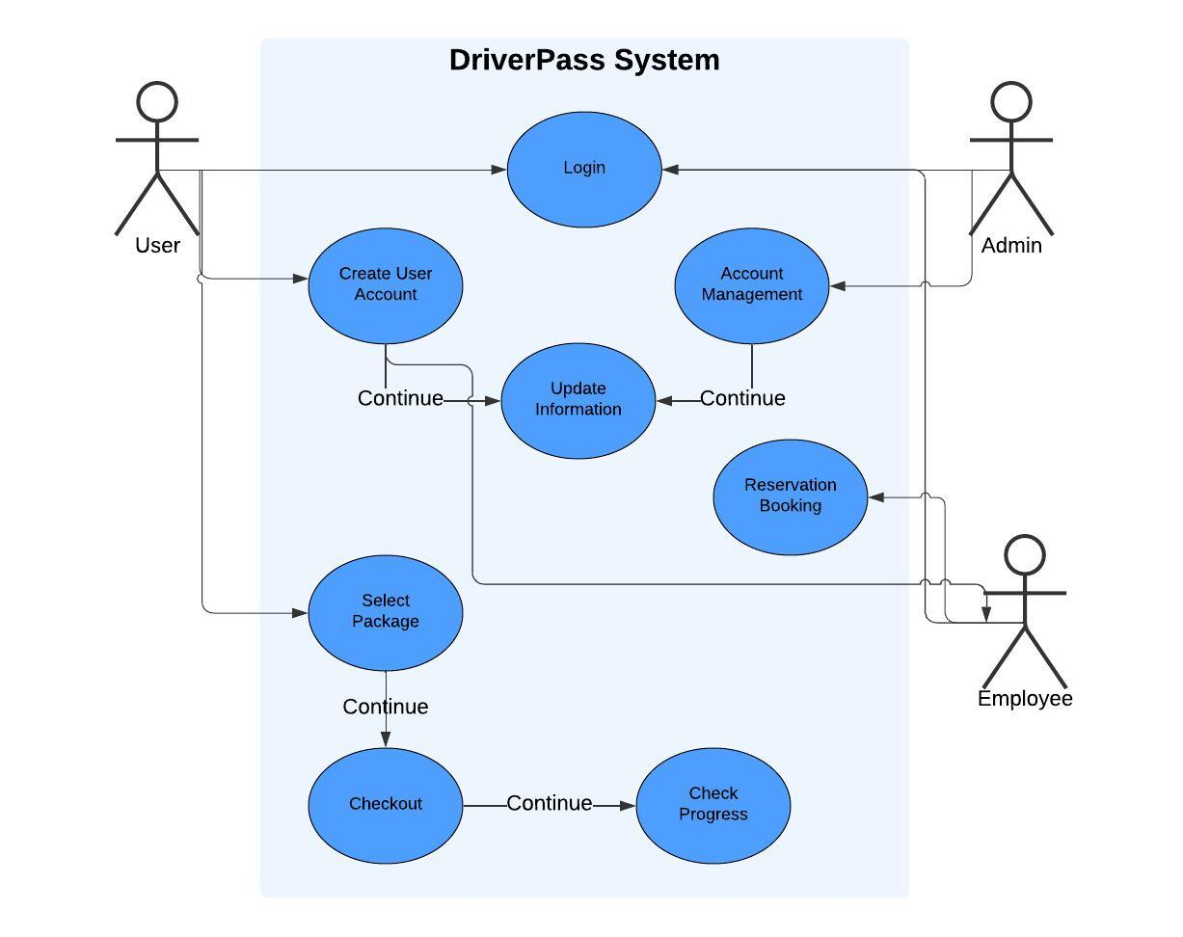
Use Case Diagram
[Insert your use case diagram here.]
Notes:
This diagram shows the various people who will be active within the system. People who have access are the individuals using the system such as students then the admin and employees for the program. All three individuals will be able to log into the system. Users can create an account and update information. Admin can also manage and update user information. Users will be able to choose packages, pay for the package and check their progress towards completion on the website. Employees will be able to see when a new user is created and book reservations for the appointments.

Slide 4
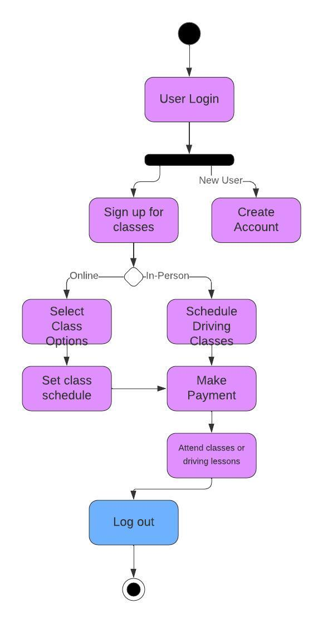
Activity Diagram
Notes:
This activity diagram shows how the student is able to log into their account or create an account. They are then able to sign up for classes either online or in person. If they are online they choose the classes and schedule that works for them then they pay for the classes that they can then attend. For inperson they will schedule the inperson driving lessons. Lastly they pay for those lessons and attend them on the date they are scheduled for.

Slide 5
Security
Confirm user identity.
Password needed for login and 2 step verification
Uses HTTPS instead of HTTP
Stops “brute force” logins
Notes:
Users must first verify their identity when creating an account. This can be done by sending a verification link to the email on file to verify the email used. It can also send a code to be entered to verify phone number. When logging in users will have to enter their password and verify through 2 step verification by typing in a code sent to email or phone number. This process helps stop brute force hackers from getting into the accounts. Last the URL of the website uses HTTPS instead of HTTP. This encrypts the personal information of the users.

Slide 6
System Limitations
Slower services in regions farther away from server.
No developer in on site
Notes:
The further away someone gets from the server the slower it will take for the website to respond. The program does not have a developer there working all the time. This can cause updates and issue fixes to take longer.

